Slide 1


New Challenges for the Marine Science : the Biological Resource Exploitment
Prof. Antonella Penna, University of Urbino
Dep. of Biomolecular Sciences
email: antonella.penna@uniurb.it ; www.antonellapenna.com

Slide 2



Blue Technology R&I BioEconomy
Biotechnology is the driving technology of the bio-economy. It contributes to innovation in all the other Activities under the bio-economy, namely food, agriculture and forestry, and fisheries and aquaculture.
Due to the very interdisciplinary nature of the bio-economy, each of the six areas under Activity 2.3 Biotechnologies is linked to a wide range of different European policies. Furthermore, they are also influenced by many international policies and strategy papers.
Biotech – Areas:
Novel sources of biomass and bio-products
Marine and fresh-water biotechnology (blue biotechnology)
Industrial biotechnology: added-value bio-products and bio-processes (white biotechnology)
Bio-refinery
Environmental biotechnology
Emerging trends in biotechnology
http://ec.europa.eu/research/bioeconomy/biotechnology/

Slide 3
Marine Bioproducts: actual and potential markets
€€ pharmaceuticals
€ nutritional supplements
€ cosmetics
€ agrichemicals
€ enzymes
€ Antifouling and antibiofilm compounds
€ Bioremediation
€ biofuels
€ Nucleotide sequences (metagenomic and metatranscriptomic)

Slide 4
The “potential” of marine biotechnology
- “Marine Biotechnology is poised on the edge of a period of tremendous potential
– potential for drug discovery
- potential for drug development
- potential for drug design
> Initial focus on drugs; now the potential is much larger: food and fuel!
Colwell (2002)

Slide 5
Contents
Food and Fuel
Marine biomass (seaweed, microalgae...)
No use of fresh water for production
Separation processes for bulk products: biorefinery
Biotechnology Research for a Complex World

Slide 6
Several marine drugs have been available for decades
- Bergmann (1950): extracted novel nucleosides
from sponges (Cryptothetya crypta)
- Synthesis of antiviral drugs and anticancer drugs:
- AZT (zidovudine, Terovir®): anti HIV
- Acyclovir (Zovirax®): anti herpes
- Ara-A (Vidarabine®): antiviral
- Ara_C (Cystosar-U®): anti leukemias

Slide 7

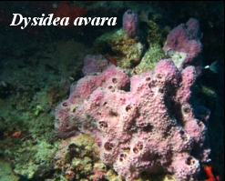
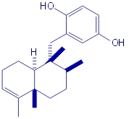
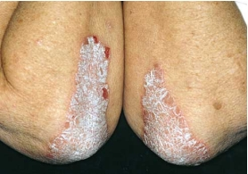
Adriatic antibacterial (Muller 1984)
Innovative research with a focus on natural compounds, particularly novel substances derived from marine flora.
sesquiterpenoid hydroquinone and quinone
Disidea avara
Avarolo 3g/kg
Cytotoxic activity

Slide 8




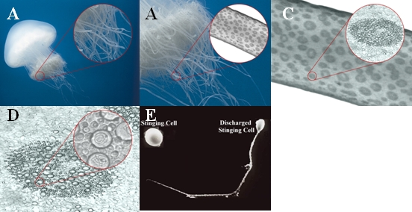
SAFE SEA
Nidaria Technology Ltd.
Zemah, Jordan Valley,
Israel, 1510501
Dual Protection
-Dual Protection from Sun Radiation and Jellyfish Stings
-Do not let jellyfish stings ruin your day at the beach!
-Our company specializes in the development and manufacture of revolutionary sunscreen products to enhance your day at the beach by protecting you from jellyfish stings and sunburn.

Slide 9
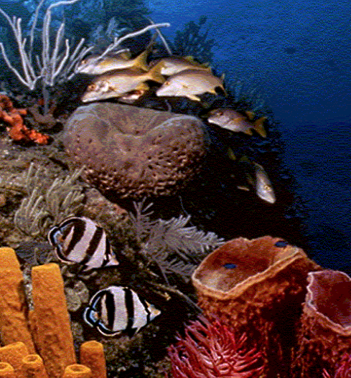
Synthetic or “natural” drugs?
Major effort from pharmaceuticl companies to develop synthetic drugs
Marine natural products still provide unusual and unique chemical structures
Lead products that mimic the natural products

Slide 10
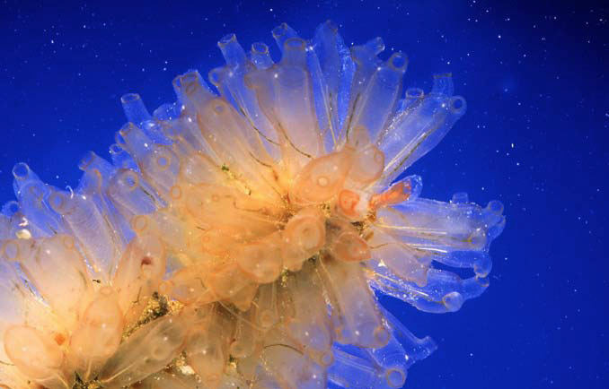
Yondelis®
Antitumor drug derived from the colonial tunicate Ecteinascidia turbinata and now produced semi-synthetically.
Developed by PharmaMar in partnership with Johnson & Johnson Pharmaceutical R&D.
Marketing authorization from the EC for the treatment of soft tissue sarcoma and ovarian cancer.
PharmaMar is marketing Yondelis in Europe; Ortho Biotech Products, L.P. will market it in the U.S. and the rest of the world, once approved.

Slide 11
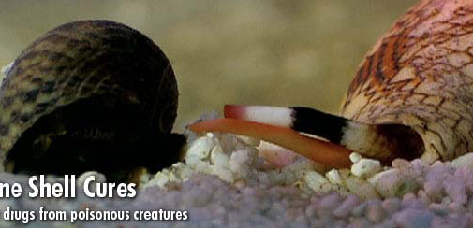
Marine Shell Cures
• Prialt ™ (aka Ziconitide, SNX-111) is a synthetic analog of the omega-conotoxin MVIIA.
• 100-1000x more potent than morphine.
• It has been approved for use by the FDA for chronic pain associated with AIDS and cancer.

Slide 12
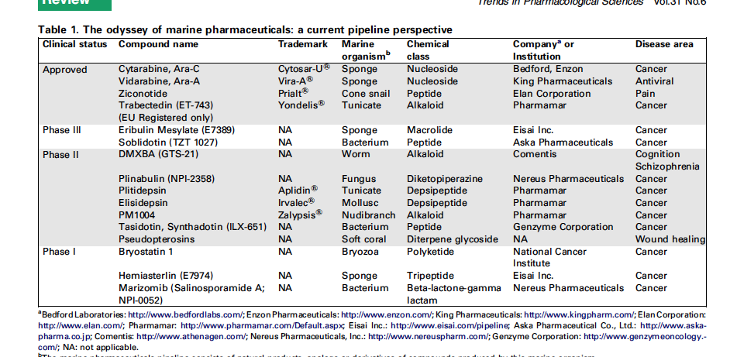
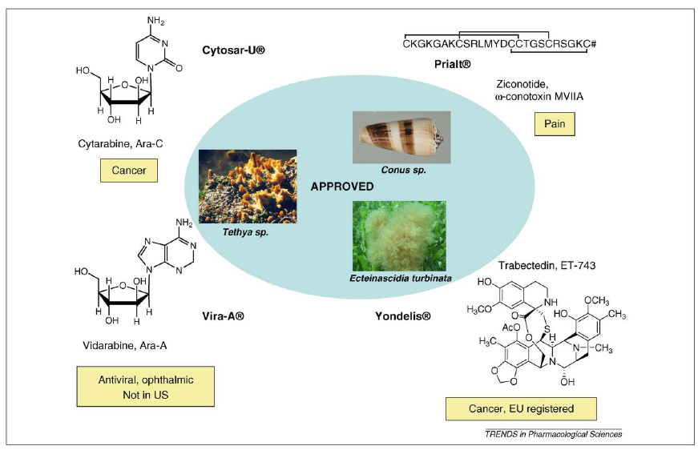
Marine pharmaceuticals: a current pipeline perspective
Mayer et al. 2010, Trends in Pharmacological Sciences

Slide 13
Marine pharmaceuticals: a current pipeline perspective
The preclinical pipeline continues to supply several hundred novel marine compounds every year and those continue to feed the clinical pipeline with potentially valuable compounds.
From a global perspective the marine pharmaceutical pipeline remains very active, and now has sufficient momentum to deliver several additional compounds to the marketplace in the near future.
Mayer et al. 2010, Trends in Pharmacological Sciences

Slide 14
Natural products: a continuing source of novel drug leads
The advent of genetic techniques that permitted the isolation / expression of biosynthetic cassettes from microbes may well be the new frontier for natural products lead discovery. It is now apparent that biodiversity may be much greater in those organisms.
The numbers of potential species involved in the microbial world are many orders of magnitude greater than those of plants and multi-celled animals.The explosion of genetic information led not only to novel screens, but the genetic techniques permitted the implementation of combinatorial biosynthetic technology and genome mining.
The knowledge gained has allowed unknown molecules to be identified. These novel bioactive structures can be optimized by using combinatorial chemistry generating new drug candidates for many diseases.
Gordon et al. 2013

Slide 15

OSD SAMPLING – EU 7FP MicroB3 Project
(Marine Microbial Biodiversity, Bioinformatics,
Biotechnology)
The Project develops innovative bioinformatic approaches and a legal framework to produced data on marine virus, bacteria and protists genomes and metagenomes for:
marine ecosystem biology and genomics
new targets for biotechnology applications
high potential commercial applications
Agreement Intellectual Properties for :
protection and sustainable use of precompetitive microbial genetic resources
exploitation

Slide 16
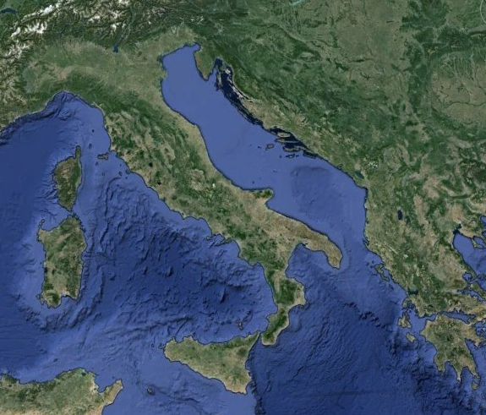
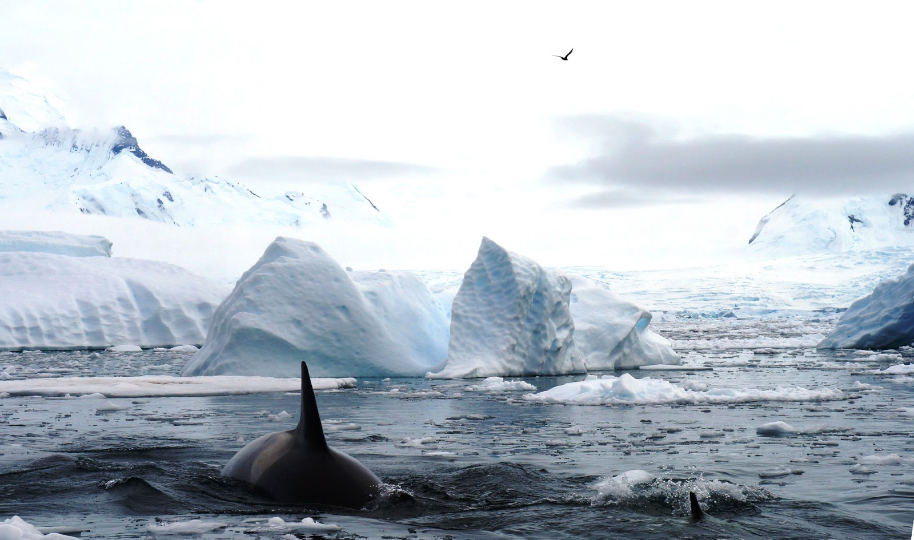

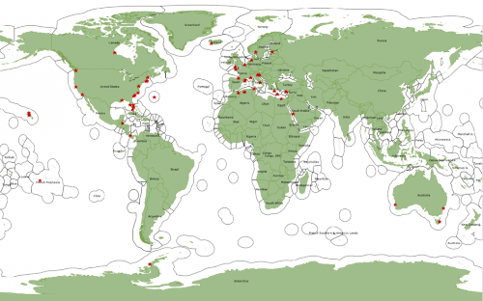
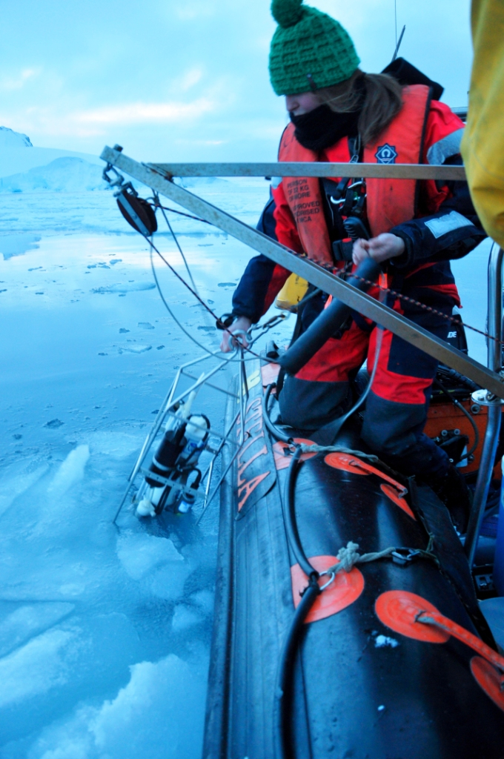
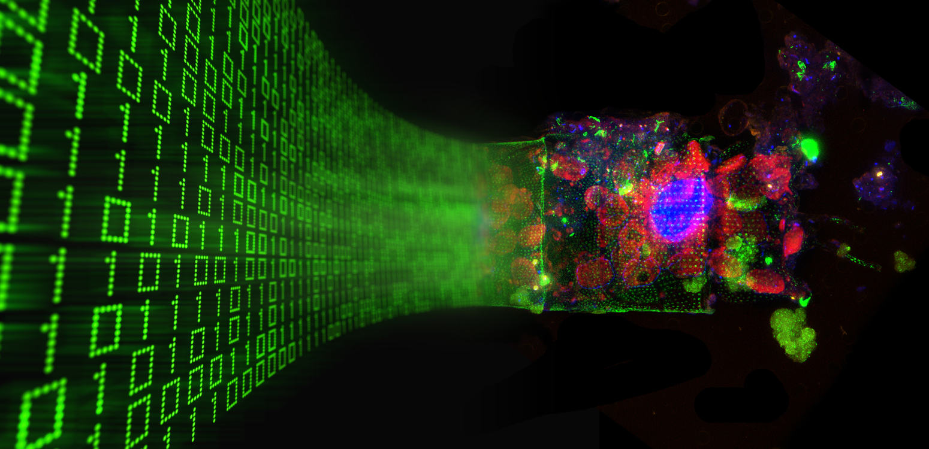
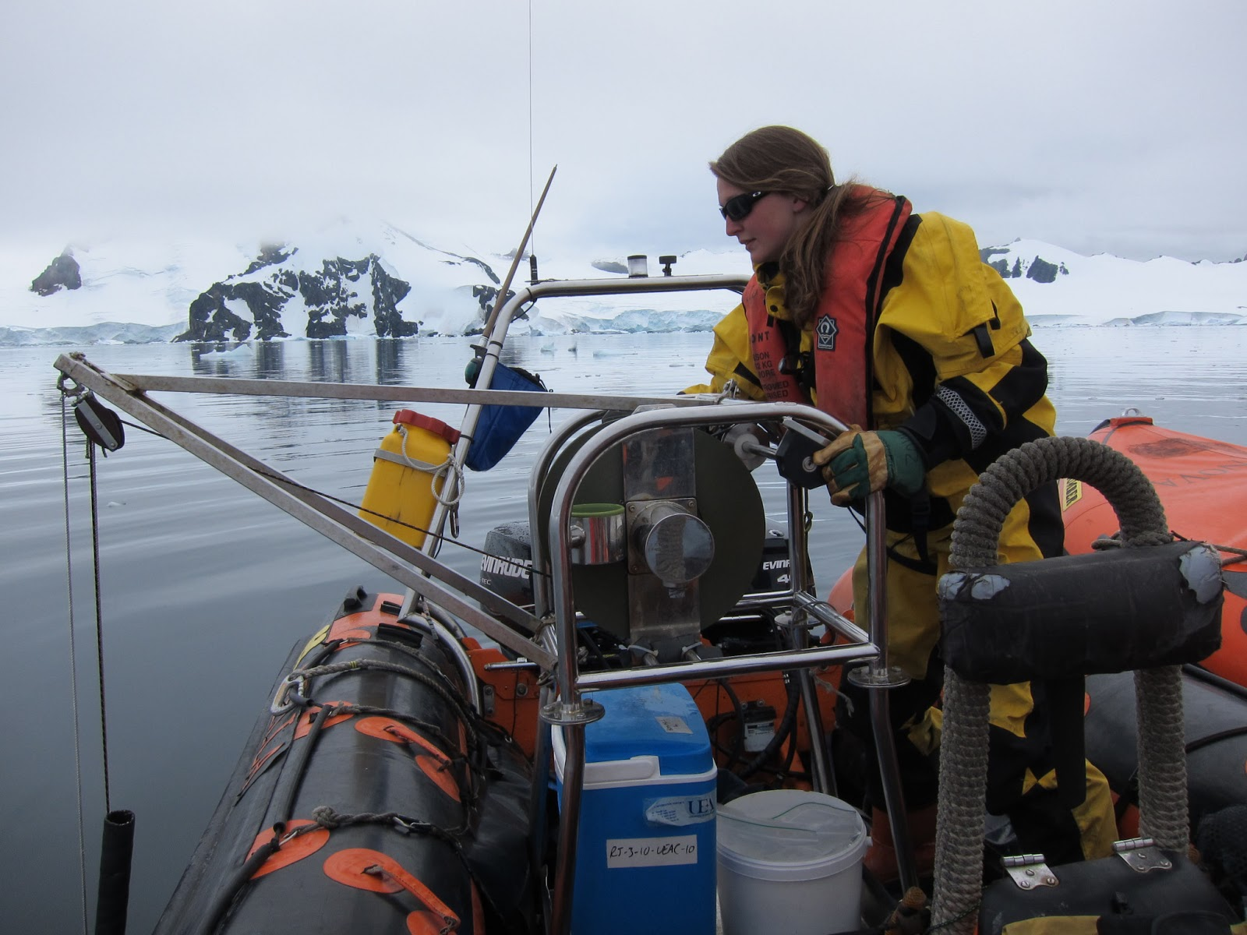
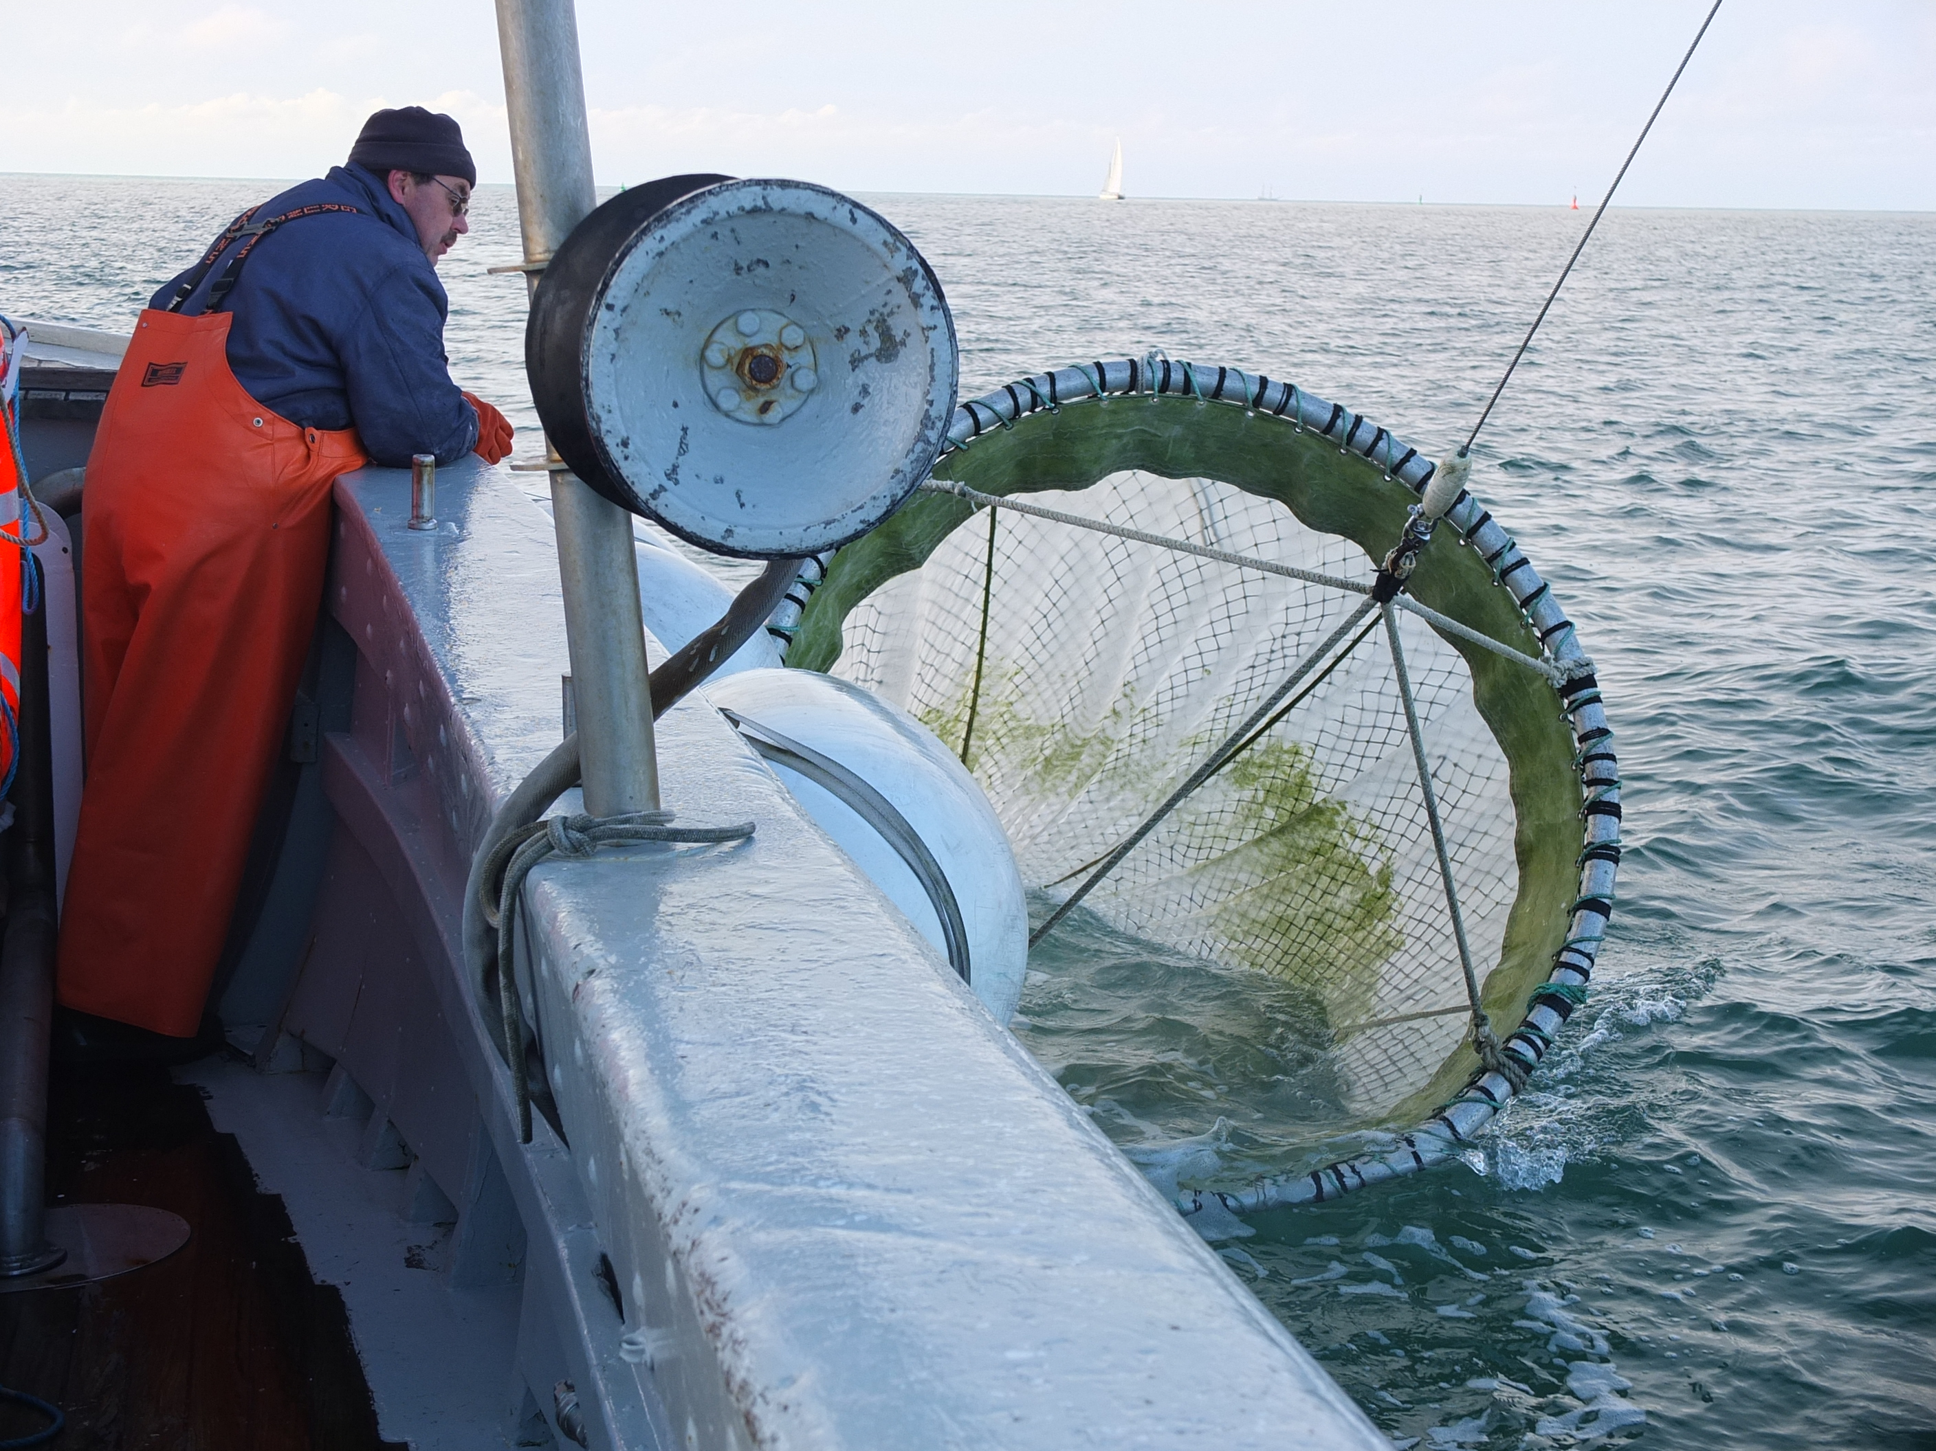
WP2: OCEAN SAMPLING DAY
Adriatic
OSD provides the largest dataset on and function in marine research.
The results will mark a baseline for the marine environment
accessible for researchers, industry, public and policy makers.
150 worlwide samplin sites
19 Mediterranean sampling sites

Slide 17
Marine Microbial Diversity - Key research priorities and recommendations - ESF Marine Board -
Increase the efforts to explore and exploit marine microorganisms for biotechnological applications and products in line with the recommendations of EU
Oceanic Metagenomic: to identify new metabolic pathways
In particular, target the understanding of signalling networks.
EU recommendations: Develop regulations and programmes for monitoring microbial changes as a result of human activities
Marine Board Position Paper 15 Marine Biotechnology :
A New Vision and Strategy for Europe. 2012

Slide 18
Access & Benefit-Sharing (ABS)
legal permits to undertake research in different maritime zones and to transfer research materials to another country.
requirements set out in the Convention on Biological Diversity (CBD)
A- Sampling in internal waters – territorial seas – exclusive economic zones
permit required∨
B- Sampling in the areas beyond national jurisdiction
No permit required.
C- Sampling in the Antarctic Treaty Area
is subject to prior notification

Slide 19


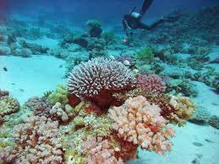
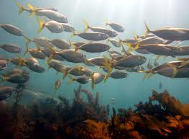
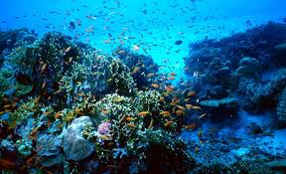
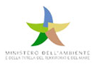
The Nagoya Protocol on Access and Benefit-sharing
- International agreement which aims at sharing the benefits arising from the utilization of genetic resources in a fair and equitable way.
- It entered into force on 12 October 2014.
- The ABS Clearing-House is a key tool for facilitating the implementation of the Nagoya Protocol, by enhancing legal certainty and transparency on procedures for access and benefit-sharing, and for monitoring the utilization of genetic resources along the value chain, including through the internationally recognized certificate of compliance.
Ministero dell’Ambiente e della Tutela del Territorio e del Mare è la Direzione Generale per la Protezione della Natura e del Mare - Divisione III
(Tutela e promozione dei valori ambientali del paesaggio).

Slide 20
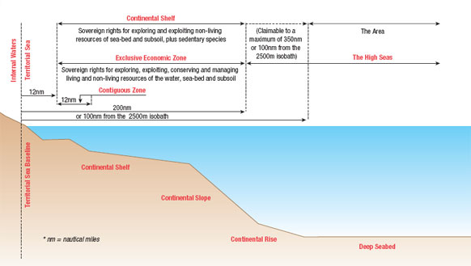
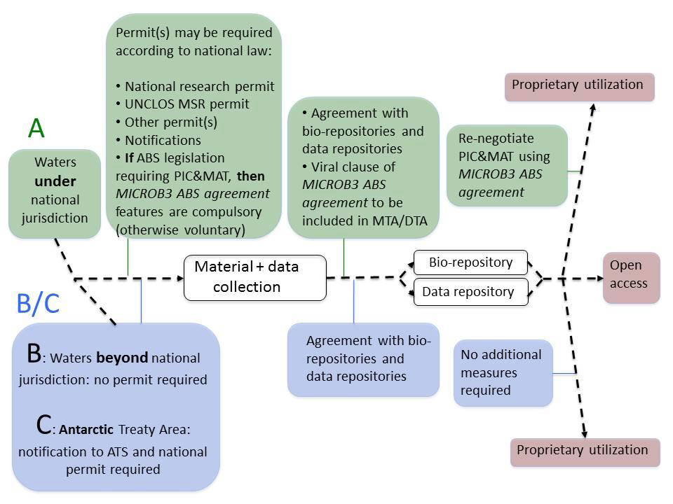
Legislation on pre-competitive access to marine microbial resources and exchange of material and data
The CBD and especially the Nagoya Protocol (NP) (not yet in force) distinguish between the general “utilization of genetic resources” and “research for non-commercial purposes” the latter being profiteer of simplified access conditions. B

Slide 21
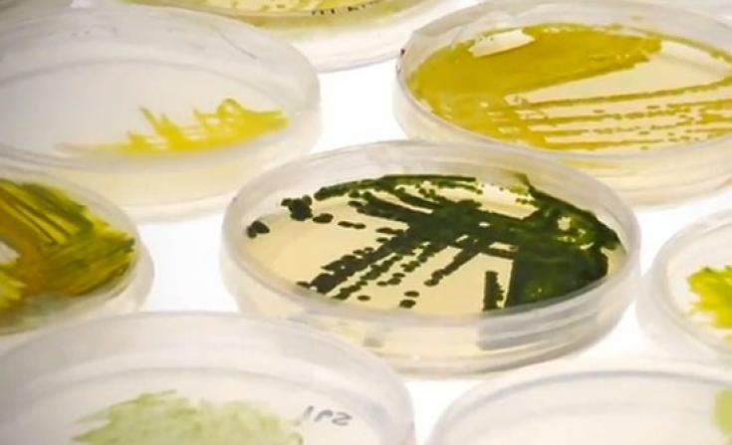
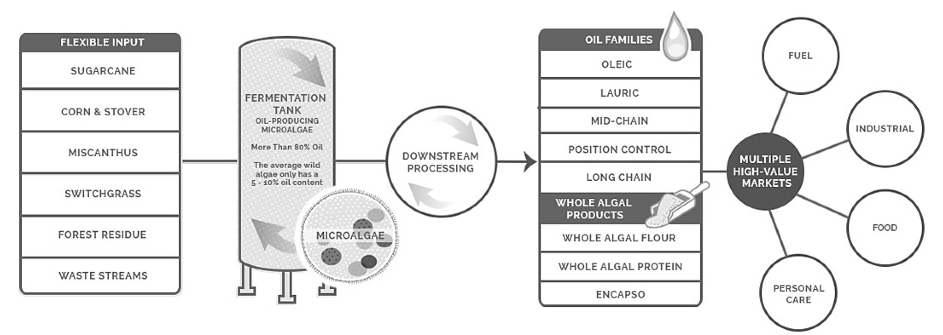

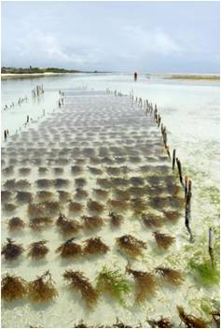
Marine Cosmetics
Companies developing industrial processes for micro and algae oil-making
Industrial Patents
Market Quotation

Slide 22
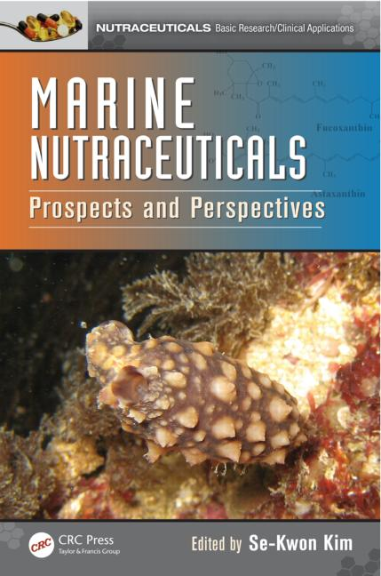
Nutriceuticals
Microalgae
Spirulina
Crypthecodinium cohnii
Chlorella
Dunaliella salina
Ulkenia sp.
Haematococcus pluvialis
Schizochytrium
Aphanizomenon flos-aquae
Euglena
Odontella aurita
Nostoc
Porphyridium cruentum
PROPERTIES
Secondary metabolites like phlorotannins and fucoxanthin, carotenoid pigments, chito-oligosaccharide derivatives from chitin and chitosan, bioactive peptides, and polysaccharides
antioxidant,
anticancer,
antiviral,
anticoagulant,
antidiabetic,
antiallergic,
anti-inflammatory,
antihypertensive,
antibacterial,
radioprotective properties.

Slide 23
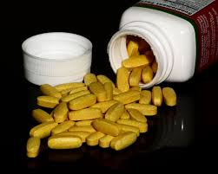
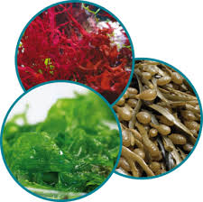
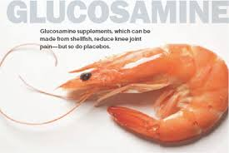

ARACHIDONIC ACID METABOLISM
Formica and Penna, Master Thesis, University of Urbino

Slide 24
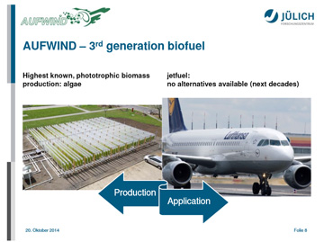
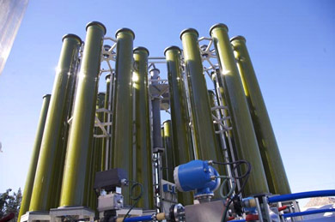
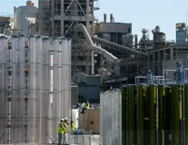
European Biofuels Technology Platform (EBTP)
Algae, cyanobacteria and aquatic plants for production of biofuels
European Projects on Algae Production and Algal Biofuels
10 Projects activities
Algal Biofuels R&D and demonstration in Europe and Globally
26 Companies & Universities
Commercial-scale demonstrations of algae for biofuels production
4 Companies

Slide 25


H2020 – Raw materials of biological origin for biorefinery
Requirements of the EU Directive on renewable energy and derive 10% of energy in conventional fuels from renewables by 2020.
ENI- EcofiningTM technology, in partnership with Honeywell-UOP.
The biorefinery will be able to produce high-grade biofuels – in particular green diesel, but also green naphtha, LPG and potentially even jet fuel – from raw materials of biological origin.
With the start up of the Green Refinery, eni will be able to produce around 300,000 tonnes per year of green diesel already in 2014. The feedstock will initially be palm oil; in the second phase, also animal fats, used oil, oils from algae and various types of biological waste.
- Renewable Energy Directive (RED) - 2009/28/CE
- Biodiesel is a fuel obtained from renewable sources (vegetable oil and/or animal fat ) using a chemical process; for its chemico-physical properties, it can partially be mixed with diesel derived from petroleum.
- Bioethanol is ethanol (CH3CH2OH) produced from biomass by a fermentation process.
- Fuel Quality Directive (FQD) - 1998/70/CE

Slide 26
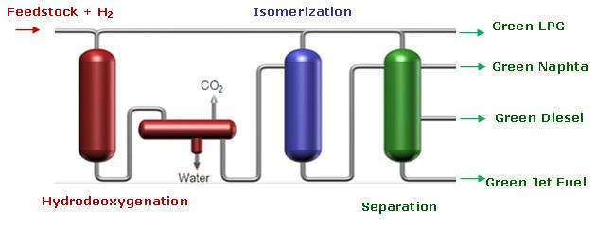
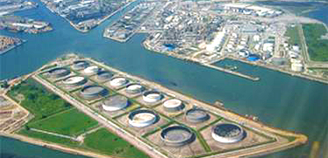
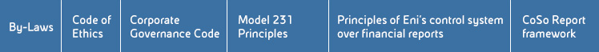
H2020 – Raw materials of biological origin for biorefinery
Green Refinery -Adriatic Venice
Outline of Ecofining process
Policy Environmental Sustainability
Eni conducts its activities in conformity with international agreements and standards and respecting the laws, regulations and national policies of the host Countries.

Slide 27



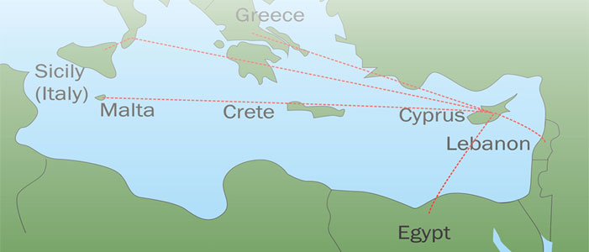
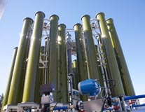
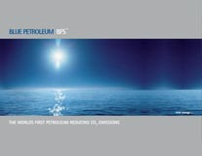
- Production of biodiesel from Algae in selected Mediterranean Countries" is a new technology project which can contribute to the goals of the EU strategy on "Climate change and energy".
- The methodology includes all stages in the production of biodiesel from microalgae: sampling of seawater or freshwater, the selection of microalgae, species identification, cultivation of microalgae, harvesting and extraction of biodiesel and determination of properties of biodiesel produced in accordance with Standard EN14214 and its testing
http://www.med-algae.eu/

Slide 28
Biofuels and Sustainability Issues
- European Policy and Standards for sustainable biomass and biofuels production
Policy and Sustainability
Deployement of advanced biofuels societal benefits of biofuels
Biofules markets
Financing and investment
Regulatory Framework
Policy and legislation , Standards and Certification

Slide 29
Conclusions
Develop regulations and programmes for exploitment and use of
sea ecosystem services by human activities (research activity, deep-sea mining, pharmaceuticals)
Increase the efforts to explore and exploit marine microorganisms for biotechnological applications and products in line with the recommendations of Marine Board Position Paper 15 Marine Biotechnology : A New Vision and Strategy for Europe *
Organise repositories for all samples, cultures and genetic materials collected during a project, and find permanent facilities to host them. Samples, cultures and genetic materials are valuable as reference for future research, but need constant care and the individual scientists cannot maintain them as part of their work.
Funding agencies need to contribute to address the loss of data collected by public funds and specify requirements for each project to permanently archive and publish data generated by the project in public data systems

Slide 30
Summary: Strategic Research and Needs- Recommendations
Exploitment
Increase exploitment of marine environment
(drugs discovery, food, biofuels).
Technologies
Develop, improve innovative technologies for the marine exploitment and pipeline analysis processes.
Data network
Generate a dense network of data on the marine ecosystem by increasing both the number and technological capacities of marine observatories.
Societal and ethical challenges & Policy
arising from these developments needs also to be correctly addressed.

