Slide 1
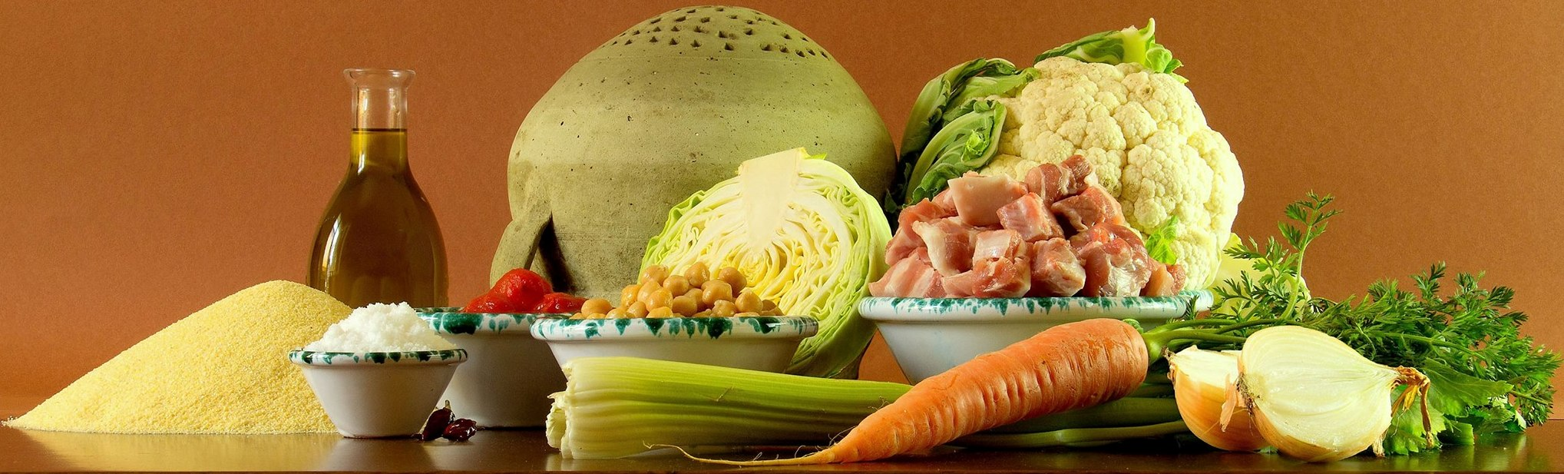
Farmers markets in the world

Slide 2
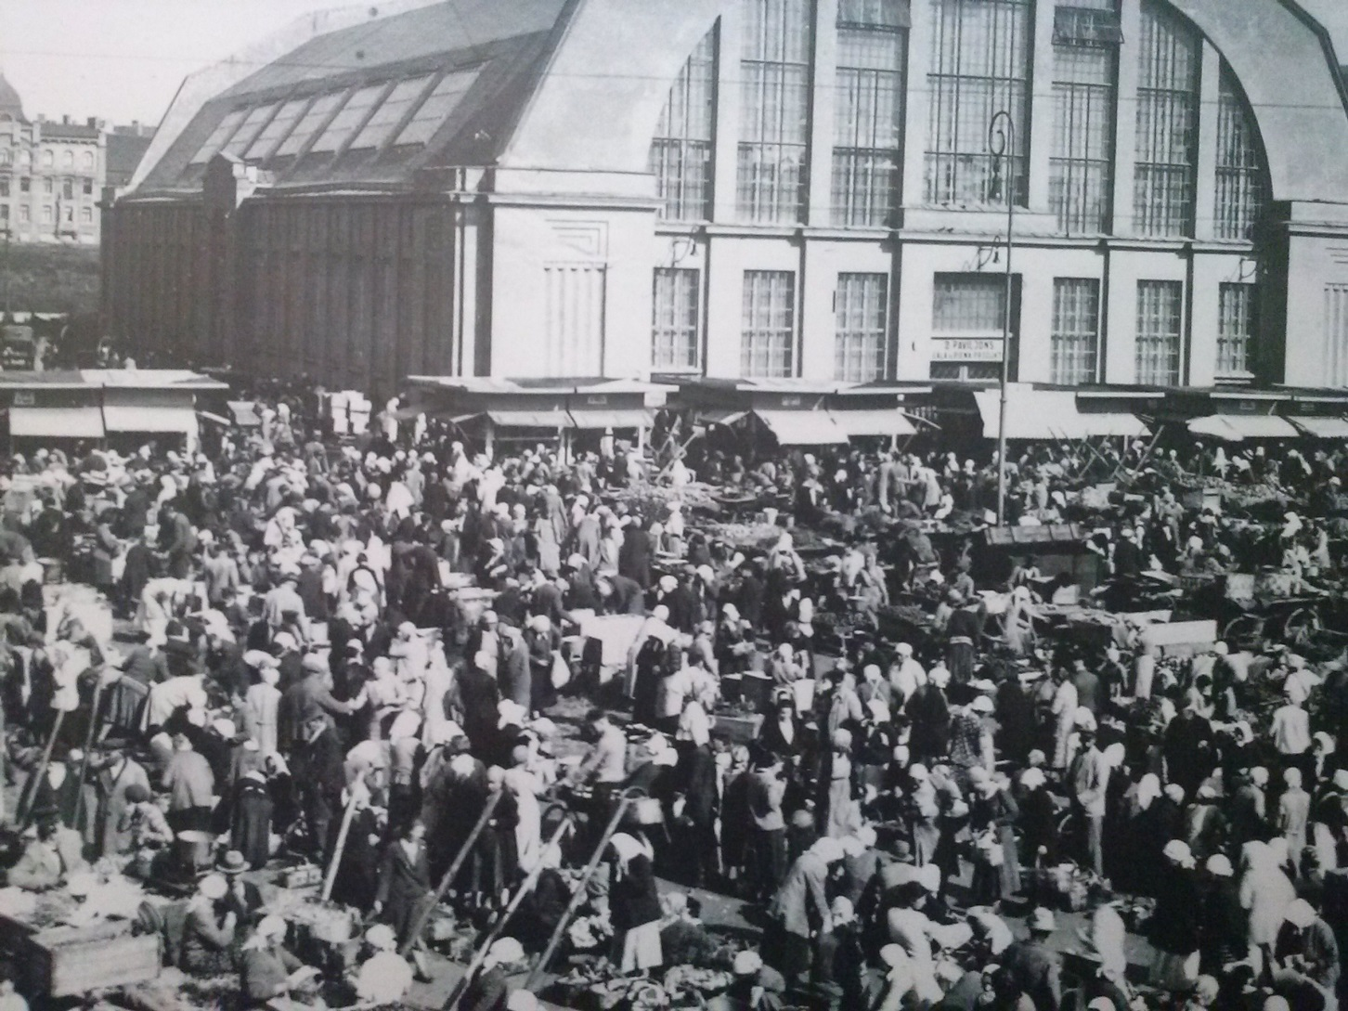
Farmers markets: anytime, anywhere

Slide 3
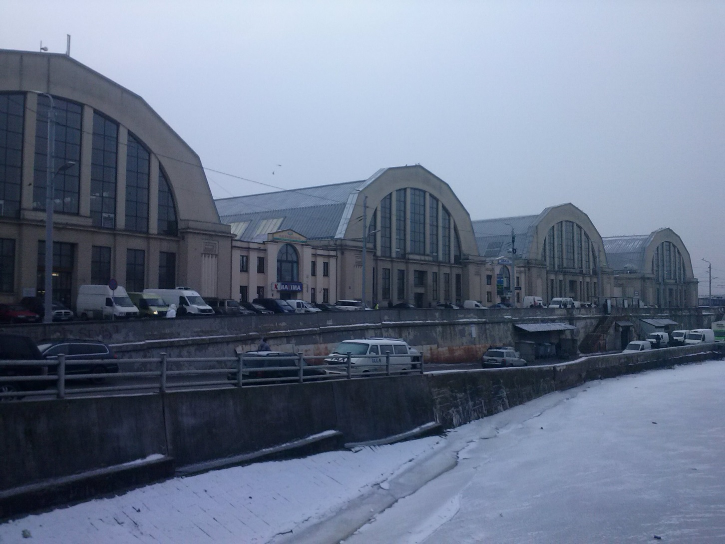
Riga - Central Market

Slide 4
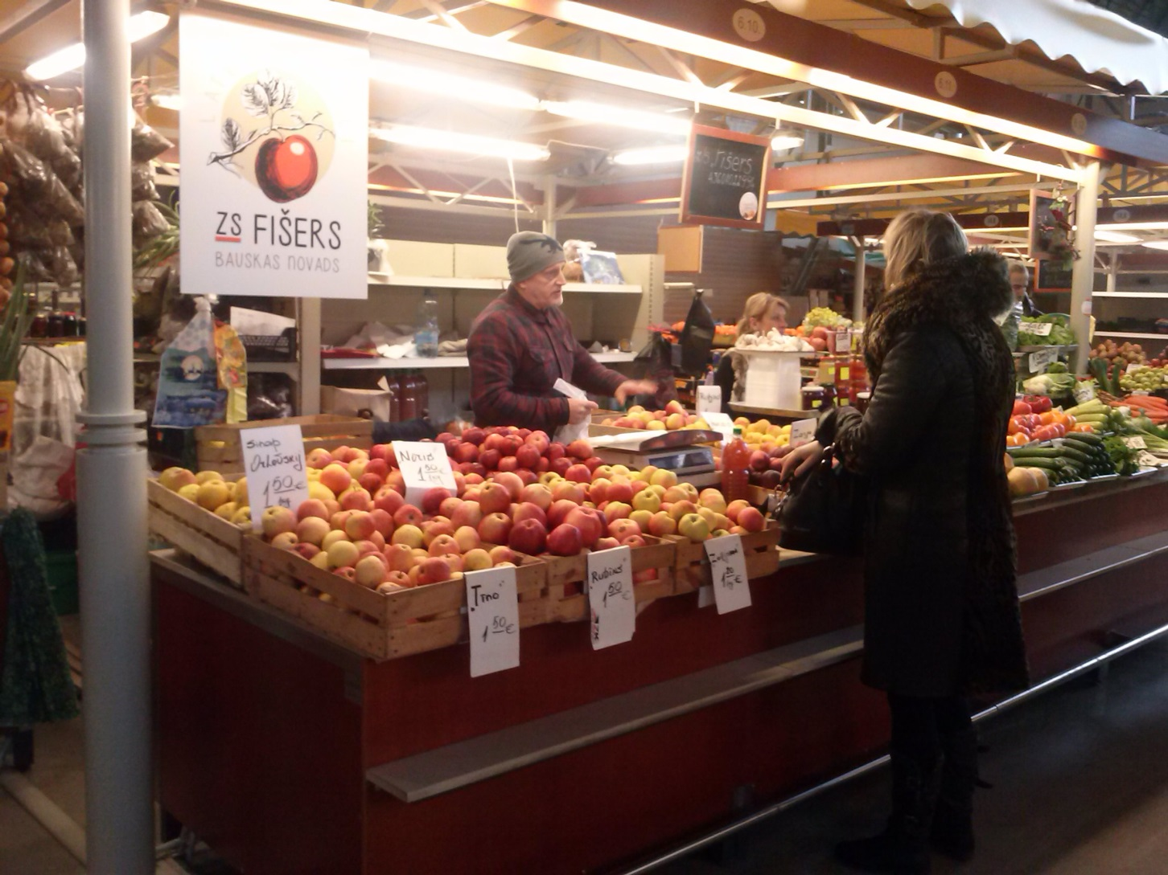
Riga - Central Market

Slide 5
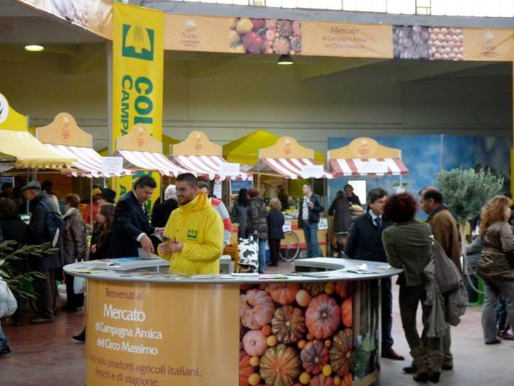
Roma Mercato Campagna Amica

Slide 6
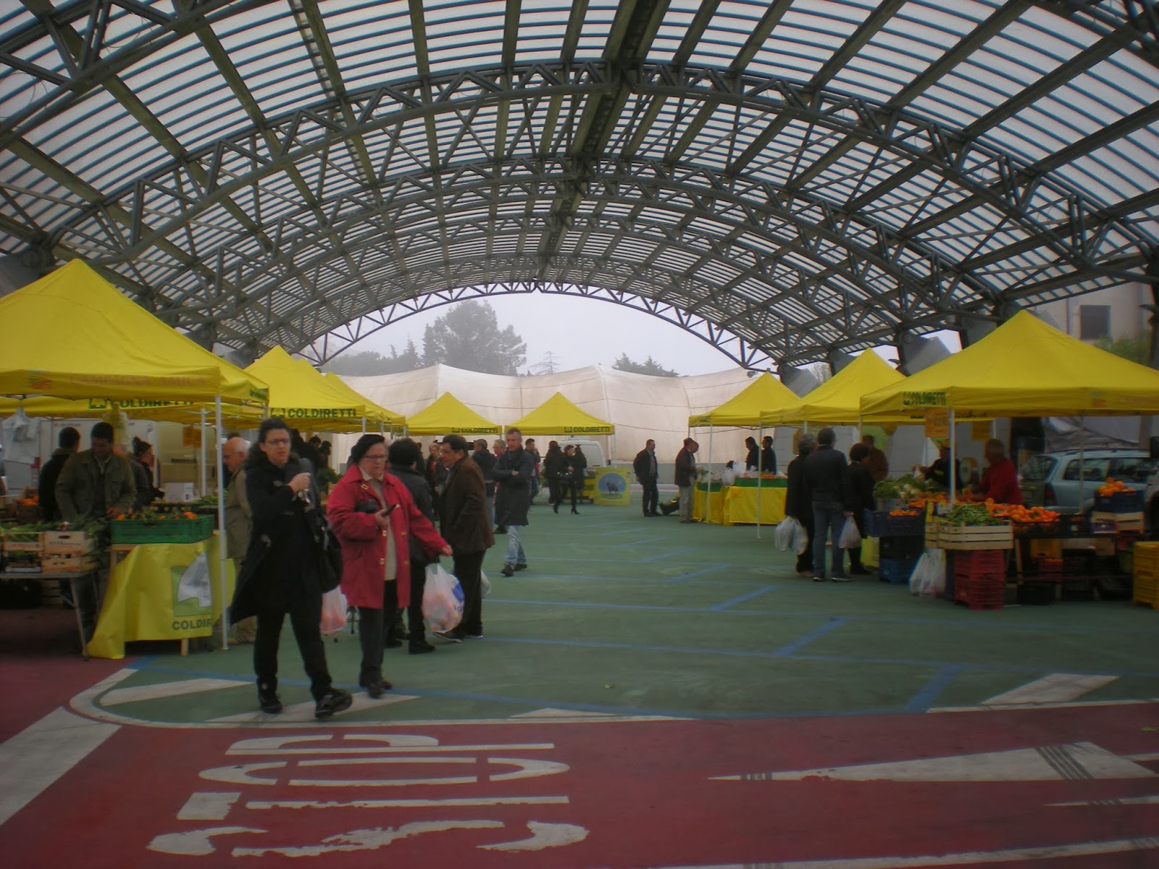
Matera Mercato Campagna Amica

Slide 7
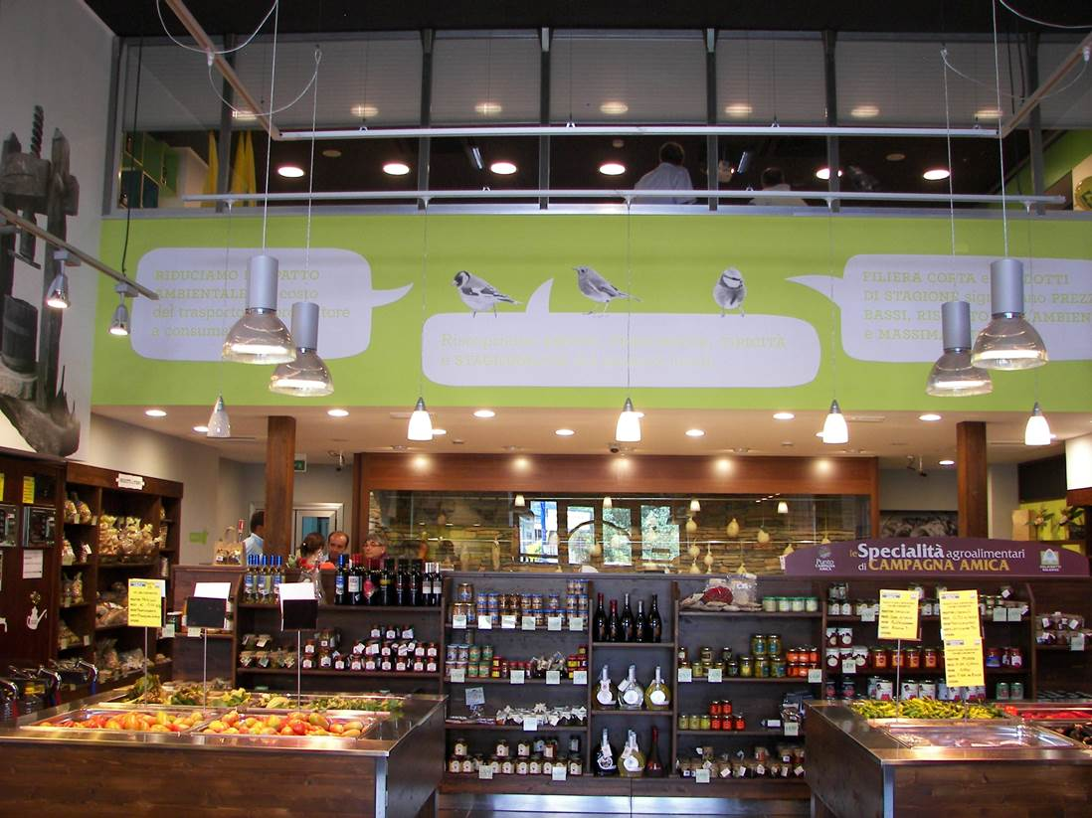
Salerno Mercato Campagna Amica

Slide 8
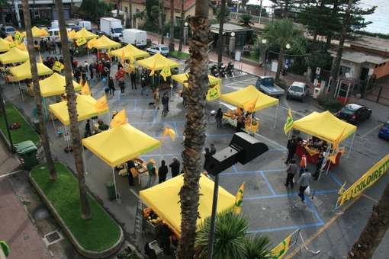
Bordighera (IM) Mercato Campagna Amica

Slide 9
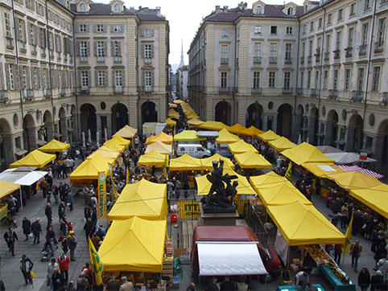
Torino Mercato Campagna Amica

Slide 10
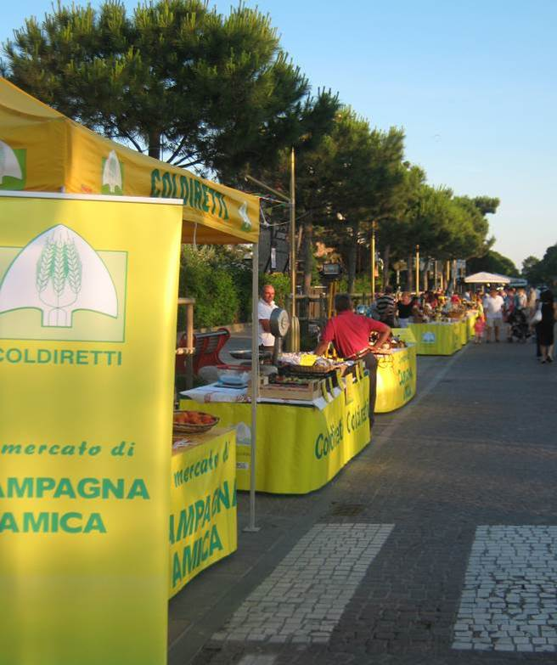
Ravenna Mercato di Campagna Amica

Slide 11
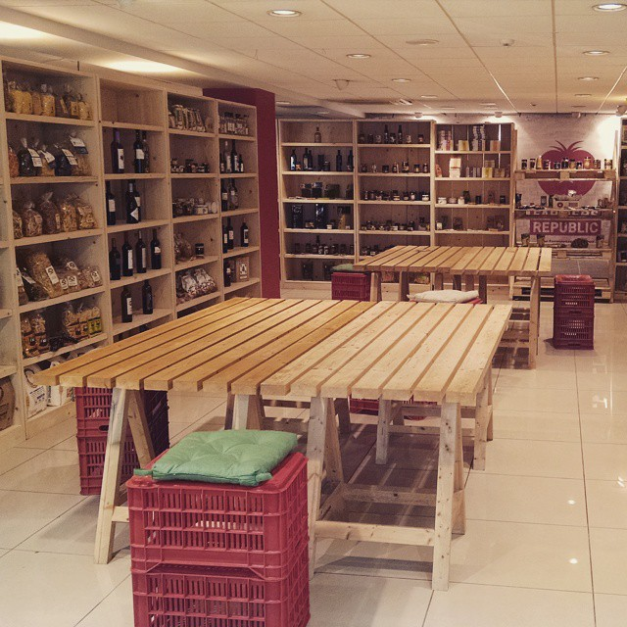
“Farmers Republic” – the Greek farmers’ market in Kryoneri, Attiki

Slide 12
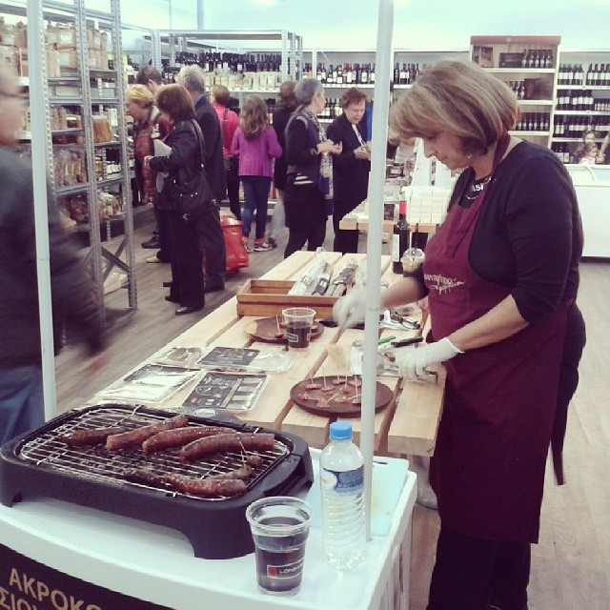
“Farmers Republic” – the Greek farmers’ market in Kryoneri, Attiki

Slide 13
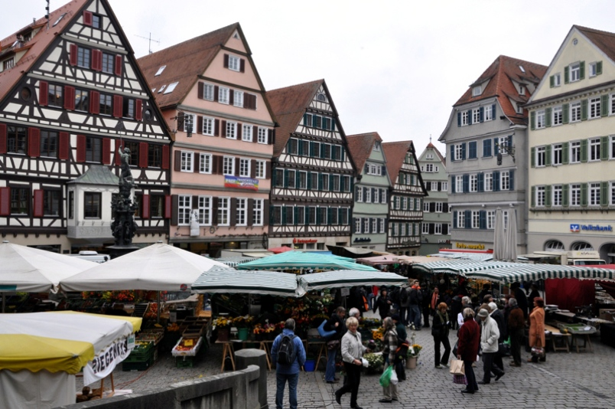
Tubinger (Germany) Farmers Market

Slide 14
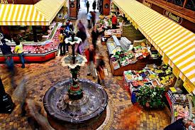
Cork (Ireland) Farmers Market

Slide 15
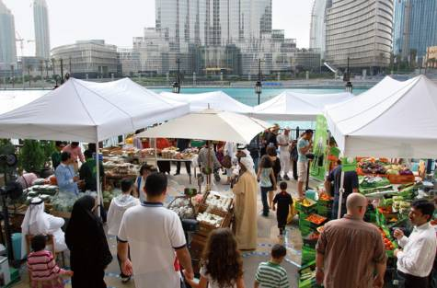
Dubai Farmers Market

Slide 16
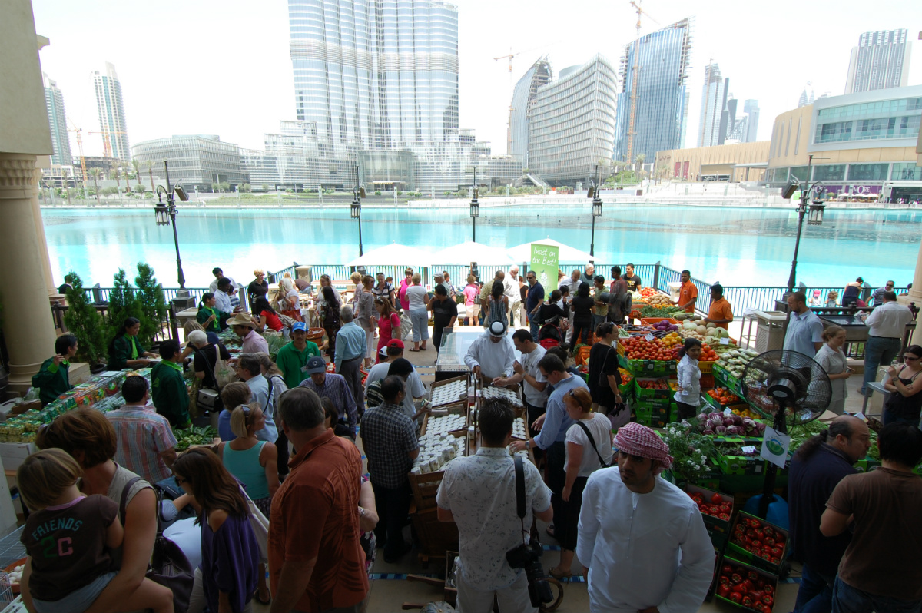
Dubai Farmers Market

Slide 17
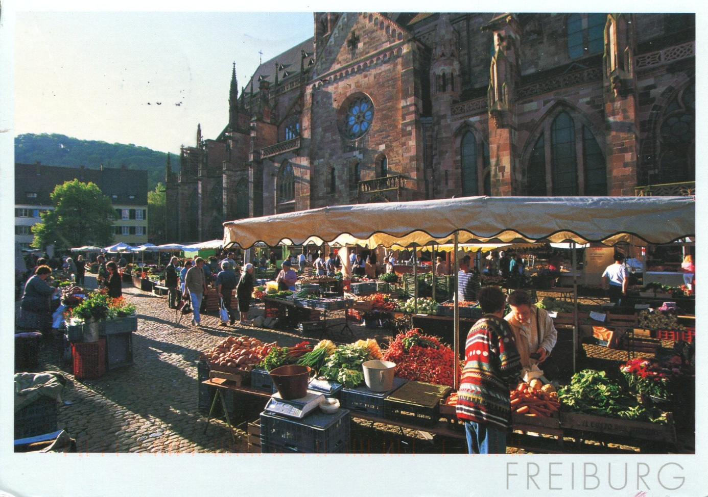
Freiburg (Germany) Farmers Market

Slide 18
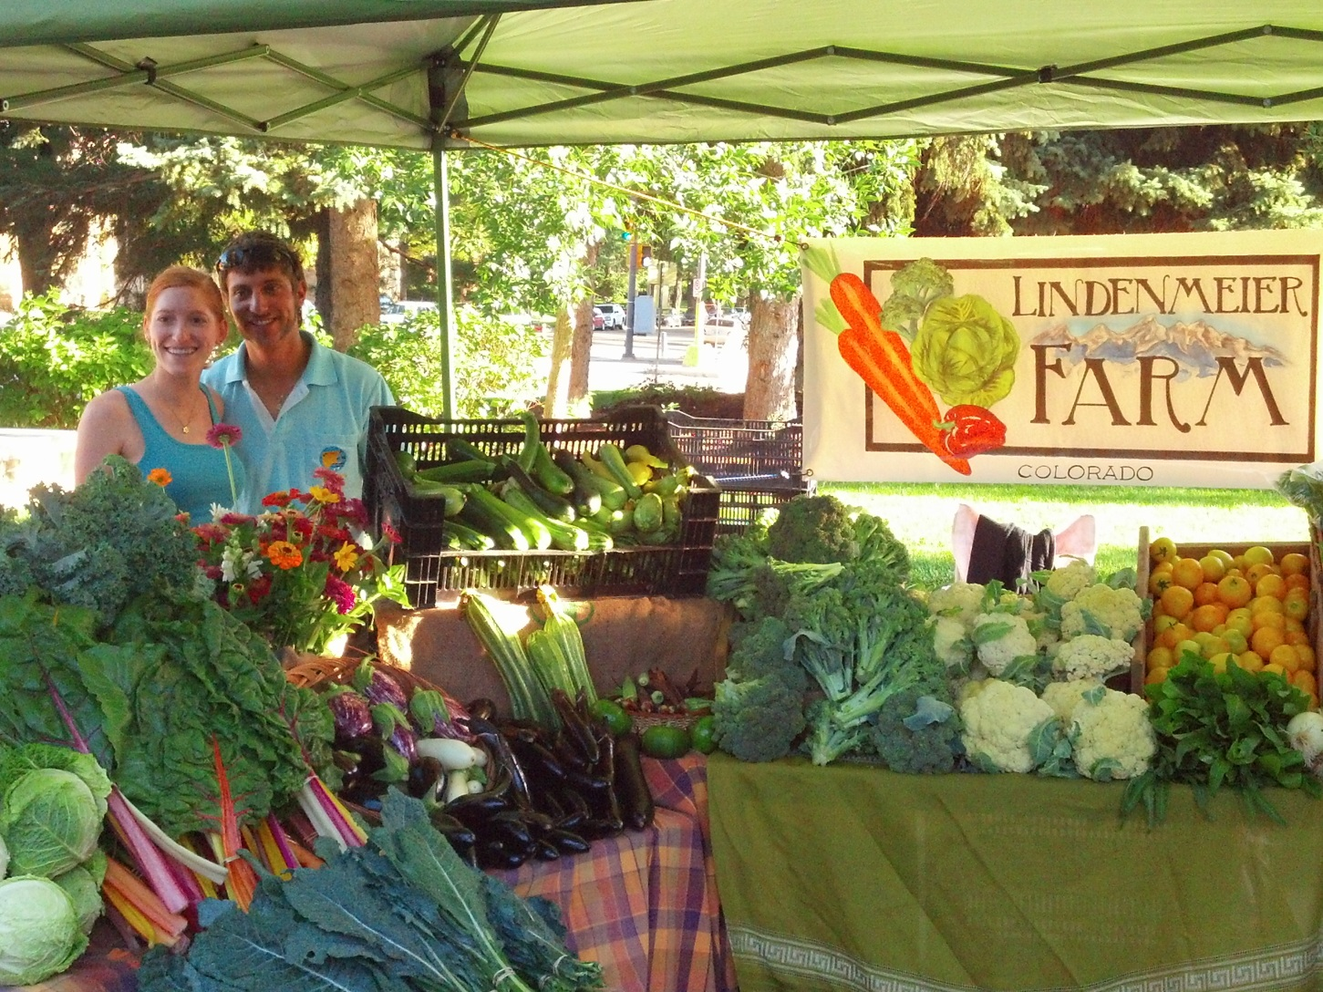
Lindenmeier (Colorado) Farmers Market

Slide 19
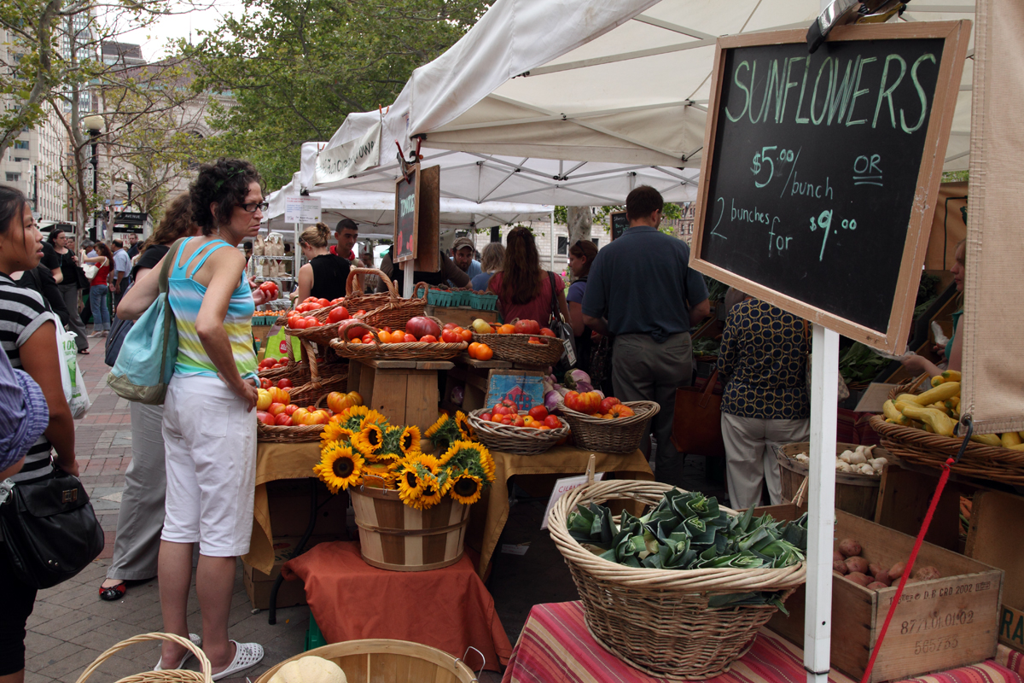
Boston Farmers market

Slide 20
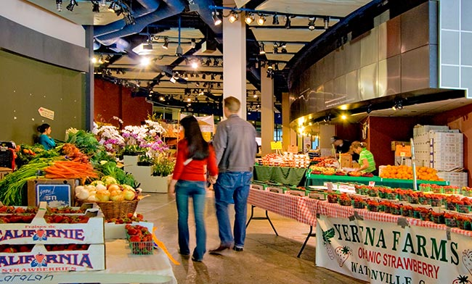
San Francisco Farmers market

Slide 21
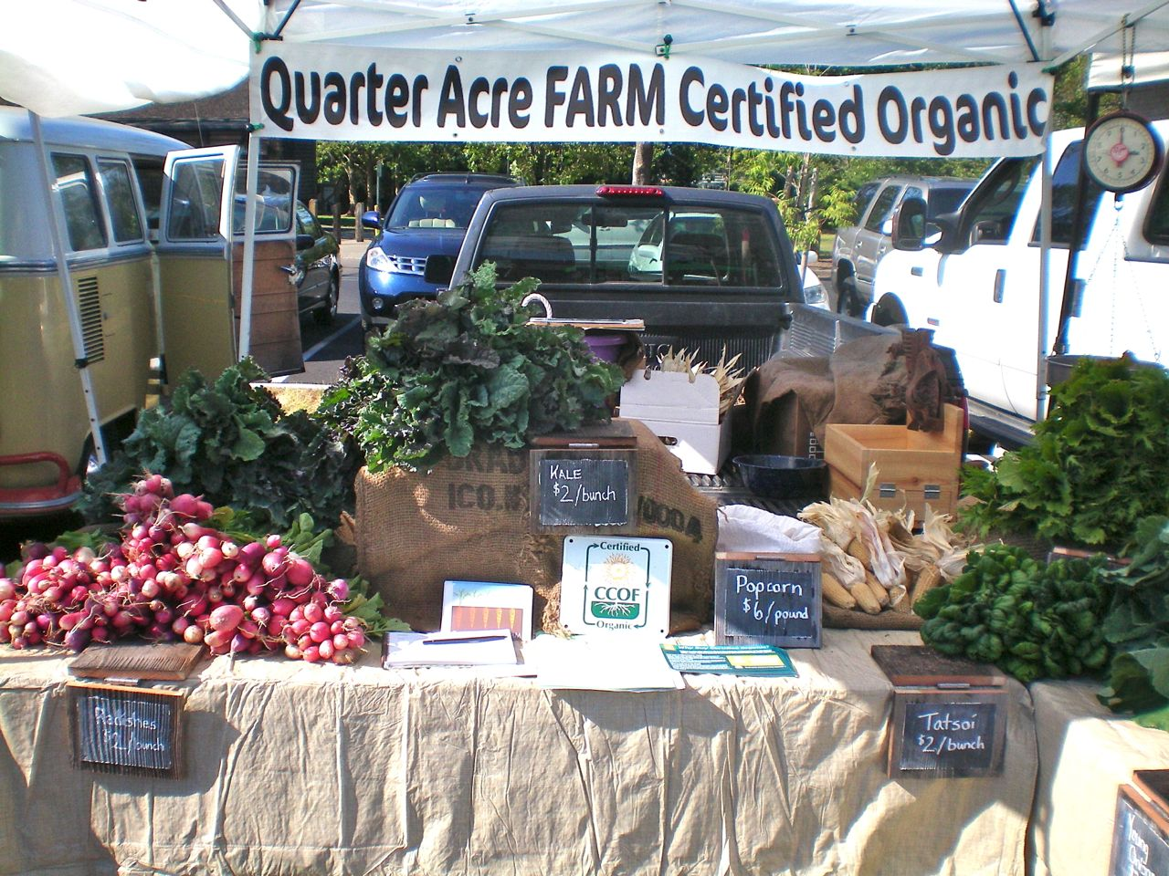
Sonoma Valley Farmers market

Slide 22
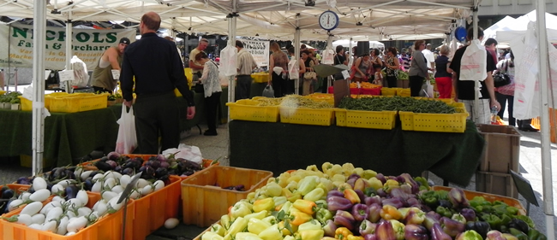
Chicago Farmers Market

Slide 23
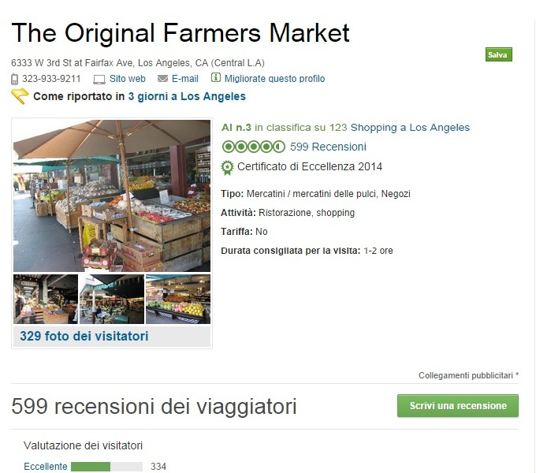
Los Angeles Farmers Market
(certificate of excellence on TripAdvisor)

Slide 24
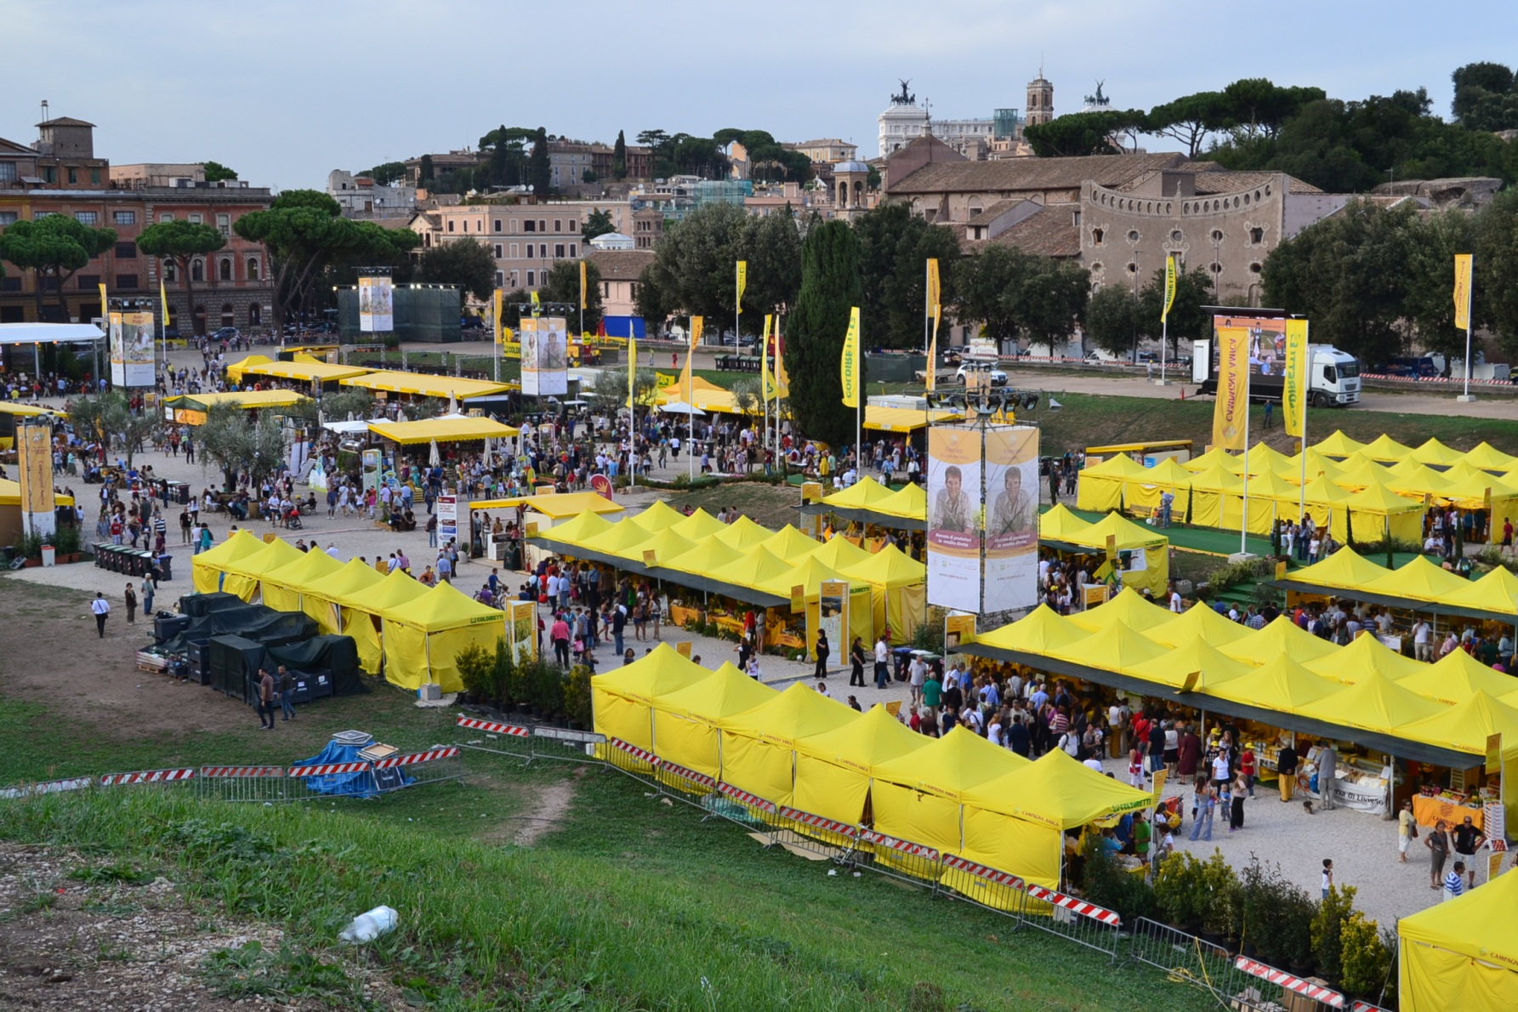
Rome first biggest event of Farmers Market «CIBI d’ITALIA»

Slide 25
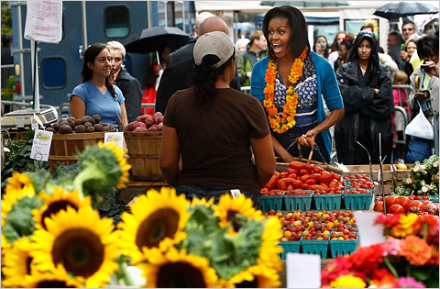
Michelle does shopping better

