Slide 1
Regional Partnerships in East Asia
Silvia menegazzi, phd
Luiss guido carli university
Presentation prepared for the workshop:
“Beyond sovereignty:
issues of cooperation in the china seas”
University of macerata
April 14, 2015

Slide 2
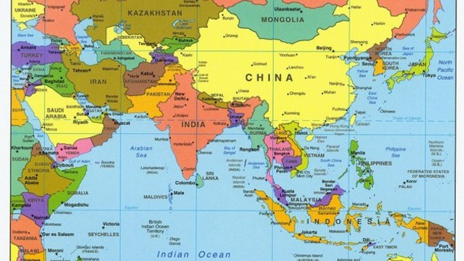
East Asia 1/2

Slide 3
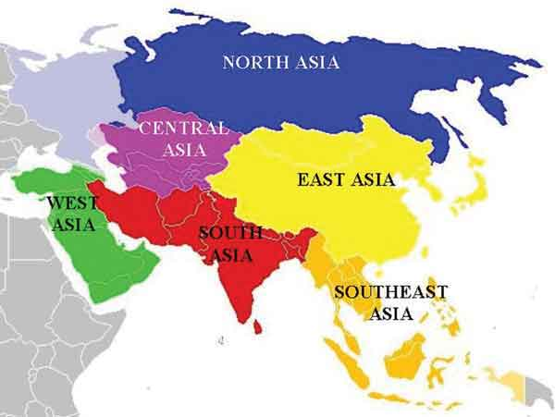
East Asia 2/2

Slide 4
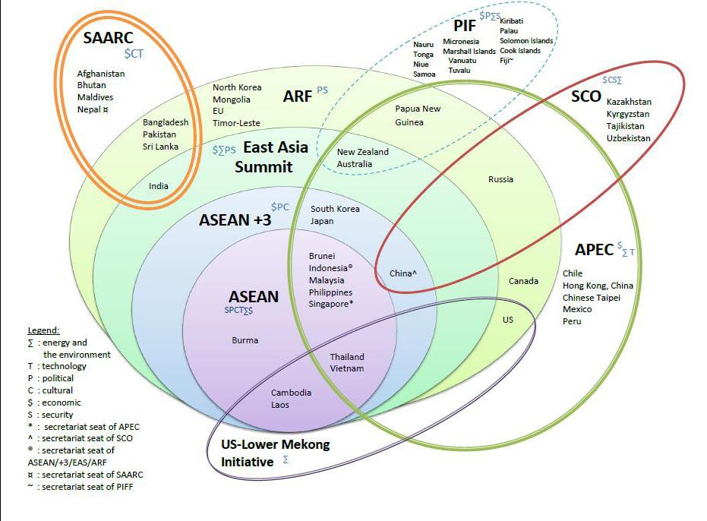
Regional Integration in East Asia

Slide 5
Maritime Cooperation in East Asia: an overview
Maritime cooperation in East Asia: a multi-faceted issue
Geopolitics
Economic development
Identity

Slide 6
Towards an Asian Cauldron?
“Europe is a landscape; East Asia a seascape. Therein lies a crucial difference between the twentieth and twenty-first centuries. Because of the way that geography illuminates and sets priorities, the physical contours of East Asia argue for a naval century.” (Kaplan, 2015)

Slide 7
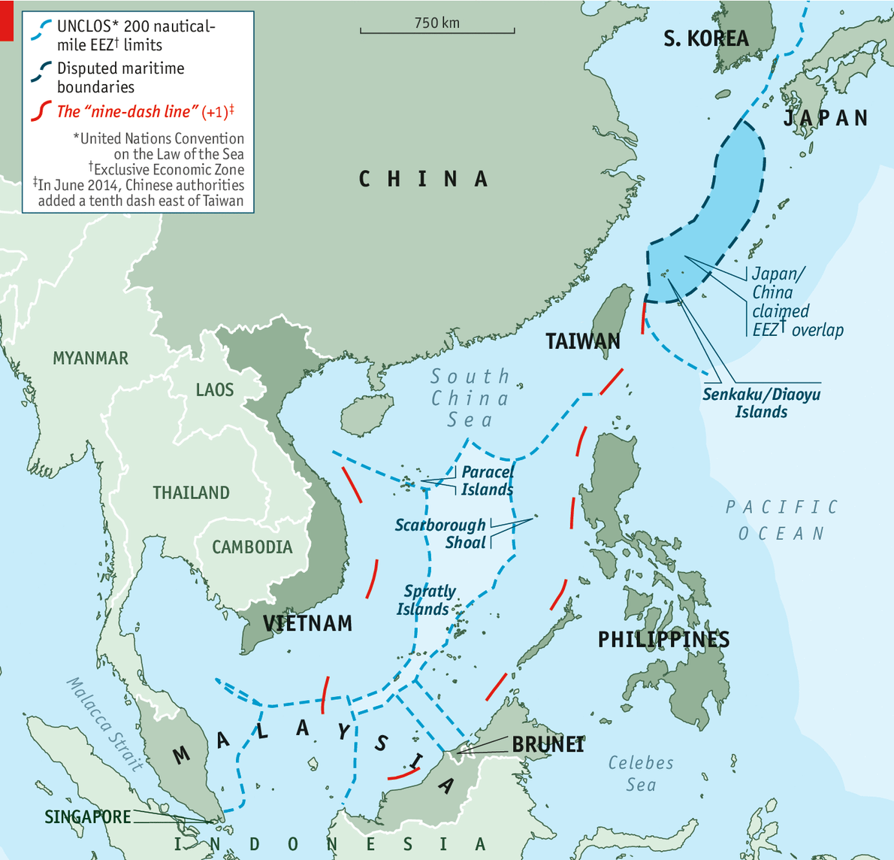
Beyond Sovereignty?
Maritime Power: Your rules or mines?

Slide 8
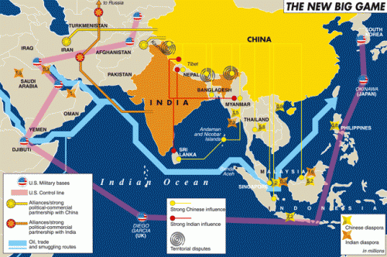

Slide 9
China’s Maritime Strategy: the debate
A MAINSTREAM VIEW, which predicts that China’s growing naval power will, sooner or later, destabilize the East Asian region in the future;
A SECOND VIEW, which instead, contends that China has limited goals in the region (Li, 2010)

Slide 10
Main issues at stake: conflicts over EEZ
The March 2001 confrontation between the US Navy Survey vessel Bowditch and the Chinese free gate in China’s EEZ;
The April 2001 collision between a US EP3 surveillance plane and a Chinese jet fighter over China’s EEZ;
The December Japanese 2001Coast Guard pursuit of and firing at North Korea spy vessel in its and China’s EEZ;
The 2009 Impeccable incident: in March 2009 in the South China Sea, five Chinese vessels surrounded the unarmed USNS Impeccable, a United States (‘US’) Navy ocean surveillance vessel, and ordered it to leave the area. The Impeccable had been conducting routine seabed mapping and tracking submarines about seventy-five nautical miles (nm) south of China’s Hainan Island.
Costal states vs. Maritime states ?

Slide 11
The puzzle concerning military activities in EEZ in Asia
The legal question: when, if ever, States may conduct military activities in the EEZ?
The law: UNCLOS is a comprehensive treaty that creates a legal regime governing the peaceful use of the ocean and its resources. UNCLOS provides guidance on various maritime matters such as pollution, environmental protection, and resources rights;
“It applies to the coastal states as well as the whole international society to advance with times regarding the norms and principles of international relations. The contemporary international system dominated by the West is facing fundamental challenges, while the non-West countries need to make their contribution to the aspects of international law, international consensus and the mainstream values”
Yang Jiemian, SIIS

Slide 12
Maritime Cooperation in East Asia
AMF
ASEAN Maritime Forum
Multi-dimensional forum to foster ASEAN maritime cooperation through dialogues, consultations policy-oriented studies and joint activities
EAMF
Expanded ASEAN Maritime Forum
First Track 1.5 mechanism on maritime issues with participation of ASEAN member states and major nations in the wider East Asia region
AMOSC
Asia Maritime Organization for Security and Cooperation
central goal would be to prevent and manage existing maritime disputes between countries by enhancing domain awareness, improving capacity-building, and enacting confidence-building measures

Slide 13
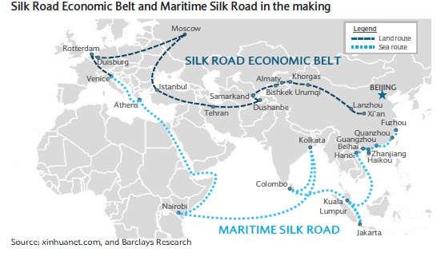

Slide 14
The Belt and Road Initiative (OBOR)
“It is aimed at promoting orderly and free flow of economic factors, highly efficient allocation of resources and deep integration of markets; encouraging the countries along the Belt and Road to achieve economic policy coordination and carry out broader and more in-depth regional cooperation of higher standards; and jointly creating an open, inclusive and balanced regional economic cooperation architecture that benefits all.”
Xi Jinping, Baoao Forum, March 2015

Slide 15
OBOR: Global reactions
UNITED NATIONS:
Jan Eliasson, deputy secretary-general of the United Nations (April 9, 2014):
"We live in the world clearly so interdependent that if things go right in one part of the world, it helps the other part of the world. If things go wrong in one part of the world, it hurts others." He said, "So in the days of interdependence, we should act also in the spirit of interdependence.”
"There is a need to increase investment in infrastructure, not least in developing countries."

Slide 16
OBOR: Regional reactions
MYANMAR (Myanmar's presidential spokesman U Ye Htut):
-the projects provide a good opportunity for the development of the Association of Southeast Asian Nations (ASEAN);
SRI LANKA (Asanga Abeyagoonasekera, executive director of the Lakshman Institute of International Relations and Strategic Studies)
-it promotes mutually beneficial cooperation between countries along the ancient sea route and share among them a vast market provided by China's economic expansion;
-Especially for Sri Lanka, which is in the post-war reconstruction, it needs to develop rapidly by being incorporated in a regional economic system;
AUSTRALIA (Merriden Varrall, Lowy Institute, Australia)
"This 'Belt and Road' is not the only part of that but an extension. It's that heightened awareness of how important that is. It reflects the growing significance that these peripheral countries have for China's national development"

Slide 17
Conclusion
China is no longer an outsider in East Asian maritime cooperation;
China is no longer keeping a low-profile in the East Asian region (21st century maritime silk road);
China’s regional identity
Beyond Western-led explanations in terms of dispute settlements in the China’s seas and cooperation activities

Slide 18
Thank you for the attention!
smenegazzi@luiss.it

